Slide 1









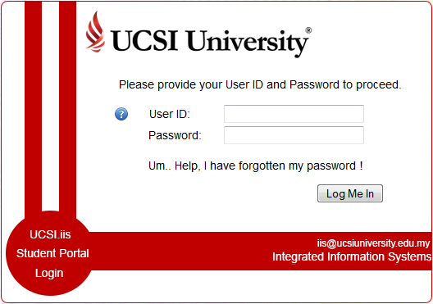

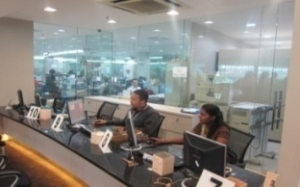

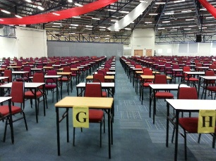





Finance Policy
Computer Lab
Campus
Rules and Regulations
International Support Team (IST)
Student Affairs & Alumni (SAA)
IIS &LMS User Briefing Slides
Library Services
Centre of Excellence for
Research, Value Innovation
and Entrepreneurship
Registrar Office
International Degree Pathway Programme (IDP)
Emergency evacuation plan SW
Examination Centre
Extra-curricular
Learning Experience
Campus Emergency
Guide
List of Policies
Building Directory
Peer Assisted
Learning

Slide 2

Finance Policy

Slide 3
Student Policy - Financial Issues
Issues:
A. Refund Policy
B. Meeting Deadlines to Avoid Penalty Charges
C. Other Financial Issues

Slide 4
A. Refund Policy:
Registration Fee & Other Fees
Tuition Fee
Refundable Deposits
EPF Withdrawals
Government Loan/Bank Loan, Financial Aid from Foundation

Slide 5
Registration Fee & Facilities Fee – not refundable
Initial Tuition Fee – International student
All initial fees paid as stipulated in the Letter of Acceptance/Conditional Letter of Acceptance are not refundable.
Initial Tuition Fee – Malaysian student – not refundable after 7 days from the commencement of the semester. Prior to that, kindly refer to the University’s Refund Policies.

Slide 6
For details, please refer to the University’s Refund Policies & Procedures which is available during the application.
It can also be referred to the University Student Handbook and UCSI website (List of Policies).

Slide 7
Refundable Deposits:
To get the refundable deposits back, the online Completion/Withdrawal Form must be submitted within 2 semesters upon the completion/withdrawal of the course.
Refundable deposits will be processed within a month upon receiving the duly completed clearance from all the required departments.

Slide 8
Refundable Deposits (continued…):
Refundable Deposits are not refundable under
the following circumstances:
Outstanding library books
Caused damages to UCSI University property
Outstanding Fee (refundable deposits will be used to offset any fees owed)

Slide 9
Employee Provident Fund Withdrawals
(for Malaysians only):
Only for Diploma/Degree Programmes
Disbursement is paid directly to UCSI University
The amount disbursed is not refundable to students
Any excess will be refunded to EPF to your parent’s Account 2.

Slide 10
Government Loan/Bank Loan, Financial Aid
from Foundation (PTPTN, Commercial banks,
Kuok Foundation, Yayasan)
Student is required to pay tuition fee according to the University’s semester deadline, NOT as and when the student receives payment from external party (eg. PTPTN).
Different parties have their own policy, and the University will follow the instructions given by the respective parties on the refund issue (if there is any excess payment).
Excess amount will be refunded provided approval has been received.

Slide 11
Payment Mode
Payment Options |  | Details
Payment Counter at Finance Office | Cash – Limited to RM 600 | Cash payments above RM600 will not be accepted for safety purposes.
 | Cheque/Banker's Cheque | Payable to: UCSI Education Sdn Bhd Post-dated cheques will not be accepted.
 | Credit Card | Only Visa, Master and American Express Cards are accepted.

Slide 12

Refund Policy
Payment Mode
Payment Options |  | Details
Banks/Internet (Payments to CIMB Bank Berhad) | Cash - Please deposit at CIMB Branches | A/C No. 86-0213894-3, payable to UCSI Education Sdn Bhd . The Customer's copy of bank Slip/receipt are to be: a) Handed to the Finance Office; OR b) Scanned and e-mailed to: finance@ucsigroup.com.my with Student ID No., Name, Contact No. and breakdown of payments. ******************************************* Please proceed to the Finance Office to obtain the official receipt 3 working days after payment has been made. Alternatively, the official receipt may also be sent through email.
Please provide/write student ID no. and name during the transaction | Cheque/Banker's Cheque. - Please deposit at CIMB Branches
 | Internet /GIRO transfers

Slide 13
Refund Policy
Payment Mode
Payment Options |  | Details
Banks/Internet (Payments to CIMB Bank Berhad) | Telegraphic Transfers (T/T) (overseas payment) Please provide/write student no. and name during the transaction | Only applicable for payment of tuition fees by International Students. Bank Details (except students of the People's Republic of China): Beneficiary’s Bank: CIMB Bank Berhad Banker’s address: 76, Jalan Cerdas, 197 & 199, Jalan Sarjana, Taman Connaught , 56000 Cheras, Kuala Lumpur, Malaysia Beneficiary’s Bank Account No.: 86-0213894-3 Swift Code: CTBBMYKL Beneficiary’s Name: UCSI Education Sdn Bhd Beneficiary’s Address: UCSI University, No.1, Jalan Menara Gading, UCSI Heights, 56000 Cheras, Kuala Lumpur, Malaysia Beneficiary’s Contact No.: 603-9101 8880 Beneficiary’s Fax No.: 603-9100 3585 (Finance Office)

Slide 14
Refund Policy
Payment Mode
Payment Options |  | Details
 |  | Bank details for students of the People's Republic of China: Same for ALL the following options: Beneficiary’s Name: UCSI Education Sdn Bhd Beneficiary’s Address: UCSI University, No.1, Jalan Menara Gading, UCSI Heights, 56000 Cheras, Kuala Lumpur, Malaysia Beneficiary’s Contact No.: 603-9101 8880 Beneficiary’s Fax No.: 603-9100 3585 (Finance Office) Option 1: Beneficiary’s Bank: Bank of China (Malaysia) Berhad Banker’s address: Plaza OSK, Jalan Ampang 50450, Kuala Lumpur, Malaysia Beneficiary’s Bank Account No.: 1-00000-4000-25654 Swift Code: BKCHMYKL

Slide 15
Payment Mode
Payment Options |  | Details
 |  | Bank details for students of the People's Republic of China: Option 2: Beneficiary’s Bank: Industrial and Commercial Bank of China (Malaysia) Berhad Banker’s address: Ground Floor, Wisma Equity, 150 Jalan Ampang, 50450 Kuala Lumpur, Malaysia Beneficiary’s Bank Account No.: 0129000-1000003-40593 Swift Code: ICBKMYKL Intermediary Bank: Bank Of New York Melon Swift Code: IRVTUS3N (for USD payment if the remitting bank is not ICBC China)

Slide 16
Payment Mode
Payment Options |  | Details
e-Payment | Credit Card (Visa and Master Cards) FPX (Savings and Current Account) | Payment for tuition fee and Accommodation fee only. Use the IIS Student Portal ID (applicable to every existing student) to access the e-Payment portal at: IIS Version 2. Any enquiry regarding e-Payment may be e-mailed to: finance@ucsigroup.com.my

Slide 17
B. Meeting Deadlines to avoid penalty charges:
Tuition fees
Course Selection
Add/Drop
Withdrawal of Course

Slide 18
Tuition Fee:
2 ¹/₂ semesters in a year (General Semester)
Fee is due about one (1) week to ten (10) days before the class commencement for each semester. The exact date will be published in the general email announcement and IIS portal. For example:
Semester Fees Due
January 2023 3 January 2023
May 2023 27 April 2023
September 2023 28 August 2023
January 2024 2 January 2024

Slide 19
Fee Statement (E-Billing) is available in the Integrated Information System (IIS) students/parents portal at IIS Version 2 before the commencement date of the semester
Late Payment Charge of 1% per month on outstanding fees calculated on a daily basis (including Repeat Courses) for overdue fees.
Ability to pay late charges is not a right to delay fees payment

Slide 20
Student with Outstanding Fees, will be barred from:
Attending class, assessment, quiz and mid-term exam.
Final examination – Exam token will not be available for printing and student with outstanding fees will not be able to attend final online assessment/assignment.
Wi-Fi, online library and internet services (IIS, LMS) will be blocked.
Denied access to IIS student portal to view results and to do Course Selection for the next semester.
Results, Official Transcript, Letter of Release will not be issued.

Slide 21
Course Selection:
Check seasonal dates (available on the IIS portal)
Course selection - 3 times a year, due about one month before the semester starts
Late submission – RM100
Also applicable to students who are barred from online Course Selection due to outstanding fees.

Slide 22
Course Selection Terms & Conditions:
You are advised to select courses ONLY if you plan to continue your studies for the coming semester because fees will be charged once your Course Selection exercise is approved.
Once the Course Selection is submitted and approved:
a. The Group Finance Office will bill you based on the number of approved subjects. You need to pay the tuition fees amount based on the number of approved subjects.
b. Facilities fees, insurance, medical plan, lab consumables and resource fee and other related fees (hereinafter referred to as “other facilities fee”) will be charged to all students (including students taking Co-Op subjects). Repeat fee will be charged for repeating the Co-Op subject.

Slide 23
Course Selection Terms & Conditions:
c. Student can access the semester E-billing via the IIS Student/Parent portal. The University will no longer send hard copy of the E-billing to your mailing address
d. Late payment charges will be imposed after the payment due date.
3) Student with outstanding fee is unable to access in-campus internet Wi-Fi, LMS/CN (Course Networking), IT and library services of the University. Computer Services Department will reinstate the access once the overdue fees are settled. Student with outstanding fees will not be allowed to attend classes and will be barred from assessment and final examination. All official transcripts will be withheld until the outstanding fees are settled.

Slide 24
Course Selection Terms & Conditions:
4) In the case of dropping the approved subjects, withdrawals from the University, termination of the studies and transfer of institution the above amount in item 2(a) and (b) will be charged.
5) If the dropping, withdrawal, termination and transfer is after the semester's commencement date without informing the Group Finance Office (via online Withdrawal Form), the University has the right to impose a charge on tuition fees and other facilities fee until your formal notification is received. In this case, refundable deposits will be used to offset any outstanding tuition fees and other facilities fee.

Slide 25
Course Selection Terms & Conditions:
6) In the case of Late Course Selection (after the online course selection period is closed), you are required to pay the tuition fees and other facilities fee together with Late Course Selection fee. The University will NOT post any E-billing to your address. You may obtain your fee information from the IIS website or contact the Group Finance Office at 03-9101 8880 or e-mail them at: finance@ucsigroup.com.my. The rest of the Course Selection Terms & Conditions under Items (1) - (3) of the above still apply.

Slide 26
Course Selection Terms & Conditions:
7) Visa Renewal - Fees Payment Policy for International Student: For all international students, if the submission of your visa renewal falls on the same time as your Course Selection period, you must pay the fees that commensurate with the Course Selection before your visa renewal process can be done. If you intend to renew your visa at any other time when your Course Selection is not due, you must first settle all your outstanding tuition fees and other facilities fee for the present semester.
Reminder: Please do Course Selection ONLY if you are confirmed to continue your studies for the next semester.

Slide 27
Add/Drop Terms & Conditions:
You are required to pay the tuition fee within four (4) days after your application for adding of a course is approved. Late payment charges will be imposed after the due date.
Add/Drop course is only applicable for continuing ACTIVE students. In the event that you drop all the courses and subsequently follow up with a Withdrawal from the University, the University will charge you the FULL fees based on the initial Approved Course Selection. Students withdrawing from the University will be subject to the Course Selection Terms & Conditions as well as the Refund Policies & Procedures of the University.

Slide 28
Add/Drop Deadline:
Normally 3 weeks after the commencement date (check Academic calendar)
After the deadline, pay RM100 per course for Late Adding/Dropping of a course
Must ensure your name appears on the class attendance sheet after Week Four, otherwise you will be barred from sitting for the final examination.

Slide 29
Withdrawal of subject(s):
After the mid-term examination
Withdrawal Subject Form
RM100 + full tuition fee on that course
Transfer of Programme
Transfer Form + RM150

Slide 30
Visa renewal :
International students are required to pay the tuition fee for the current or coming semester, for e.g.
Visa Due Pay Fee for Semester
November 2022 January 2023
April 2023 May 2023
July 2023 September 2023
November 2023 January 2024
Please make early arrangement for the payment of your tuition fee to avoid delay in your visa renewal. Last minute request will not be entertained.

Slide 31
Other Issues:
Tuition Fee payment- always remember to pay the tuition fee on time and in full amount
Request must be in writing
Update your contact number to receive latest information via SMS
Update your latest mailing address to avoid undelivered mail

Slide 32
Charges will be imposed on all returned mails
Bank charges on returned cheque and late payment charges
Check emails

Slide 33
Important Reminder:
Please pay all fees before the Orientation (30 Aug 2023)
Class will commence on 4 Sep 2023

Slide 34

Computer Lab Briefing

Slide 35
Computer Lab Briefing
Computer lab rules and regulations
Disciplinary actions
How to… Windows login account and student e-mail
Wireless information
WiFi requirements

Slide 36
The following are BANNED
Installation of any software including freeware / demo / trial / shareware, etc.
Loud/distracting behaviour or group activities in the computer labs.
Do not lock the workstations after use.
Do not bring/consume food in the labs.
Internet chatting, web-phoning, video-streaming.

Slide 37
The following are BANNED
Using our facilities to earn income in any form.
Abuse of the printing facilities.
Do not unplug any of the cables (etc, power cables and LAN / Internet Cable).
Do not flip down the monitor.
Please shut down the computer after use.
Please clean up after use and rearrange the chair to its original place.

Slide 38
The following are ILLEGAL
Hacking and introducing of virus of any kind.
Giving someone authorised access (giving away your password).
Downloading and storing obscene materials.
Downloading of MP3 or similar material.

Slide 39
Disciplinary Action
Verbal warning (1st warning)
Formal written warning (2nd warning recorded on file)
Withdrawal of user account/access

Slide 40
How to… Windows Login Account and Student Email
Username = Student ID
Password = Please take note that the password will be sent
to your alternate email from Registrar Office. The
password should be the same as your IIS password
Log on → UCSIHQ
-------------------------------------------------------------------------------
Student E-mail: https://www.google.com/a/mail.ucsi.edu.my (please see below)

Slide 41
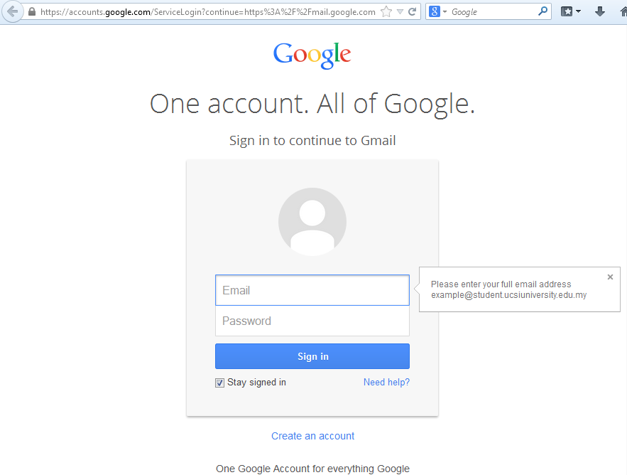
----------------------------------------------------------------------------------
Username: Student ID@student.ucsiuniversity.edu.my
Please take note that the password will be sent to your alternate email from Registrar Office. The password should be the same as your IIS password

Slide 42
Wireless Information
For your Username and Password, kindly follow your IIS logon credentials.
Please log on to the “Connect@UCSI” wireless profile.
We advise you to use the 11ac WiFi product for better connection speed.
The 11ac products are available now. However, if you want to use your existing wireless card, please ensure you abide by the requirements.

Slide 43
WiFi Requirement
https://ucsiuniversity073.sharepoint.com/:f:/s/StudentAffairsandAlumniGroupSAAGroup/El3nBm4G-9VJgWgx1Q1X2ycBToLntpoKshvEyoVWGCPTMQ?e=9MNGm5
Please make sure that your IP Address is set to DHCP and there are no more configurations need to be done.
IEEE 802.1x standard (recommended “AC” standard – 1733Mbps).
Can support WPA2 (WiFi Protected Access).
128 bits or more encryption support.

Slide 44
Configure Wireless & Internet
Please proceed to the Computer Service Department (CSD) for your wireless access problems.
We only accept laptops that are running Windows XP platforms and above. (Windows XP Home/ Pro, Vista, 7,10)

Slide 45
Kindly Remember
Pendrive, FlashDrive, ThumbDrive users have to ensure the device is free from virus.
Always remember to wear your Student ID Tag.
DO NOT save your work ON THE DESKTOP.
CSD DOES NOT BEAR responsibility for the loss of any data or information.

Slide 46
Campus Rules and Regulations

Slide 47
SECURITY
D
EPARTMENT
IBU PEJABAT POLIS DAERAH CHERAS
Address: Balai Polis Cheras, Polis Diraja Malaysia, Lot 36 Jalan Cheras (Taman Maluri), 56100 Kuala Lumpur, Malaysia.
No. Tel: 03- 9205 0222
PONDOK POLIS TAMAN CONNAUGHT
Address: Pondok Polis Taman Connaught, Polis Diraja Malaysia.
No. Tel: 03-9101 3222
PONDOK POLIS TAMAN TAYNTON VIEW
Address: Pondok Polis Taman Taynton View, Polis Diraja Malaysia.
No. Tel: 03-9131 5022
CHERAS FIRE STATION
Address: Balai Bomba & Penyelamat Cheras, Jalan Manis 1, Taman Segar, 56100 Kuala Lumpur.
No. Tel: 03-9132 9490
EMERGENCY CONTACT
In the event of any emergency, please call 03-9101 8880 ext 3189 (SW) or 5401 (NW)
Student may refer to the campus emergency guide at
http://www.ucsiuniversity.edu.my/pdf/campusEmergencyGuide.pdf
Direct line to all emergencies (Police Station, Fire Station (BOMBA), Hospital, Jabatan Pertahanan Awam Malaysia (JPAM) is 999

Slide 48
• AVOID BACKLANES/ DARK AREAS !
• AVOID ATTENTION !
• WALK AGAINST TRAFFIC
• Avoid walking on your own. Coordinate your schedule with your fellow students or friends to walk to and from your classroom together. This will help to reduce the risk of being targeted by a potential assailant. Use the University shuttle bus service whenever possible.
SECURITY
D
EPARTMENT
SNATCH THEFT
GANGSTERISM
DRUGS
ROBBERY
SEXUAL OFFENCE
• BE ALERT !
• DO NOT SIMPLY TRUST ANYBODY !
• AVOID EXPOSING WEALTH !

Slide 49







Slide 50

Making A Difference
The Student Affairs & Alumni (SAA)

Slide 51



The Student Affairs & Alumni (SAA) division
makes a difference in the lives of UCSI students by rolling out a series of activities and providing services which pertain to different needs and situations.

Slide 52
The five departments at SAA
Alumni & Support Services
Co-Operative Placement Centre
Student Activities & Recreation
  Student Council
Sports & Fitness
Student Development & Counselling
  Best Buddies Programmes, Peer Counselling & UniYouth

Slide 53
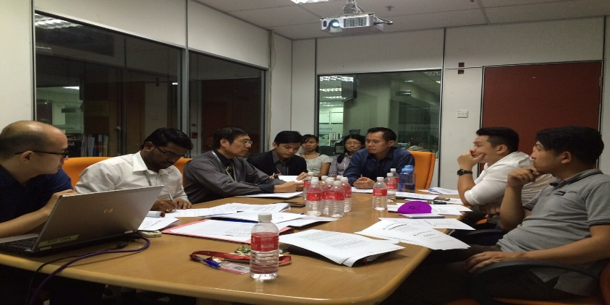
Alumni & Support Services
UCSI University Alumni Network
What We Do
Build and nurture lifelong relationships with UCSI alumni (graduates & staff) through the UCSI University Alumni Network.
This extended network provides alumni with ongoing benefits and opportunities to remain part of UCSI for life.
Develop contacts with local & international UCSI graduates.

Slide 54
Engage with lifelong learning, personal & professional development via programs organized by the Alumni Network.
Affiliate with other organizations, clubs and societies with similar objectives.
For more information, please visit http://www.ucsiuniversity.edu.my/ucsialumni/
Our Facebook Page: https://www.facebook.com/ucsialumni

Slide 55
On Campus Accommodation
(South Wing & North Wing)
Our Roles:
To ensure our services and facilities enhance the students experience;
To maintain the cleanliness and upkeep of the residential halls;
To ensure security and safety in the residential halls;
To facilitate integration between the residents and ensure that on-campus accommodation rules and regulations are adhered to.
To ensure students would enjoy their learning and living experience at UCSI University.

Slide 56
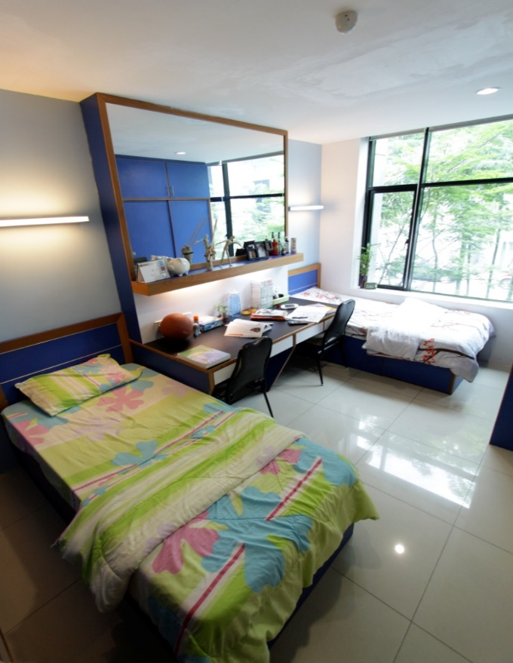
Accommodation Services
What We Do
We offer students on-campus (Residential Hall) accommodation which is housed within the campus – an arrangement which is extremely safe, affordable and convenient.

Slide 57


Residential Hall Block D
Residential Hall Block E
UCSI University Kuala Lumpur Campus
No 1, Jalan Menara Gading,
UCSI Heights, Cheras,
Kuala Lumpur.
UCSI University Kuala Lumpur Campus
No 1, Jalan Menara Gading,
UCSI Heights, Cheras,
Kuala Lumpur.
+603-9101 8880 Ext 3451
+603-9101 8880 Ext 2000

Slide 58
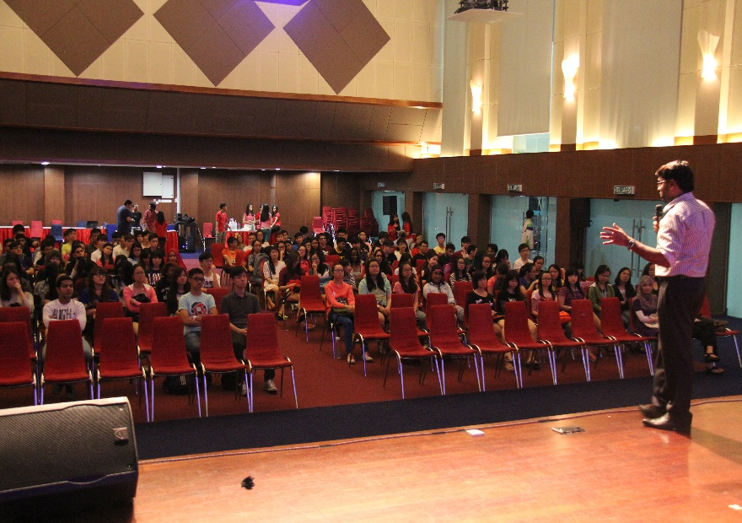
Our Residential Halls provide twin-sharing air-conditioned rooms. The Hall is divided into male and female quarters and is equipped with a common visiting area for family and friends.
The Residential Halls provide the following facilities:
Air-conditioned rooms
A launderette
An in-house cafeteria
Board Games such as chess, carom and checkers
24-hour wireless Internet service
Individual room cleaning
Shower rooms with hot water
A TV lounge for each floor
Surau (Prayer Rooms)
24-hour security

Slide 59
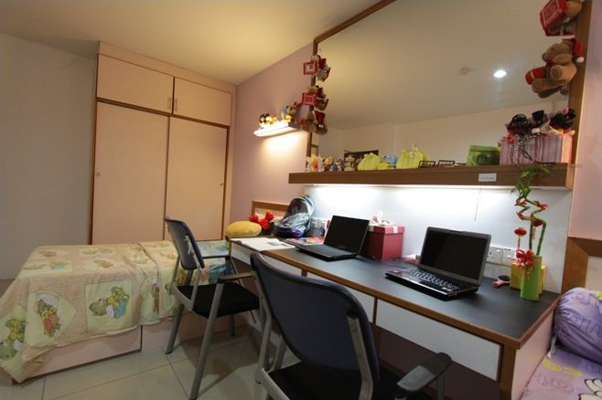
Our Facilities
Room Items:
Bed with mattress and pillow
1 set of bed sheets and pillow covers
Study table and chair
2-door Wardrobe

Slide 60
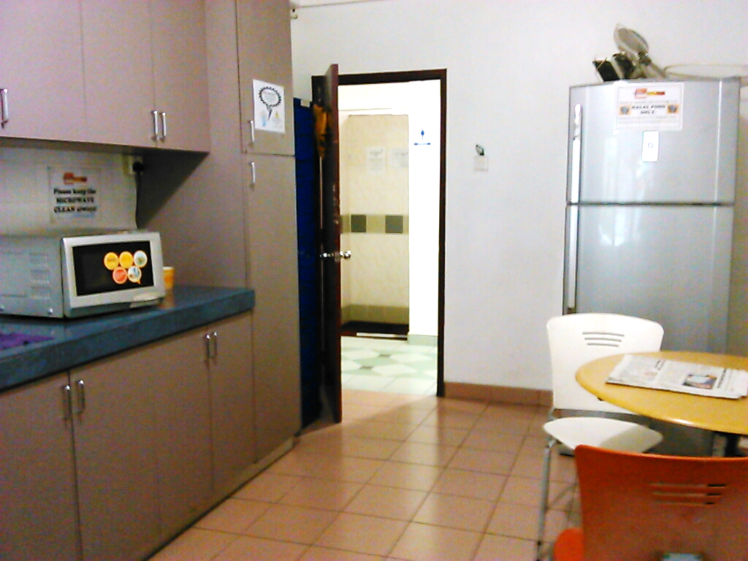
Pantry Items:
Hot water dispenser
Microwave oven
Refrigerator
Built-in kitchen cabinets

Slide 61
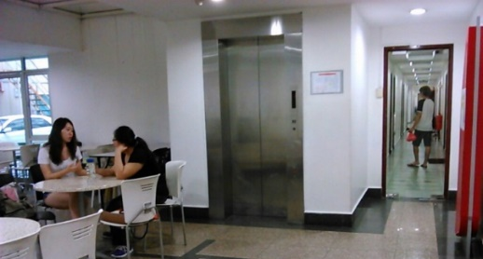
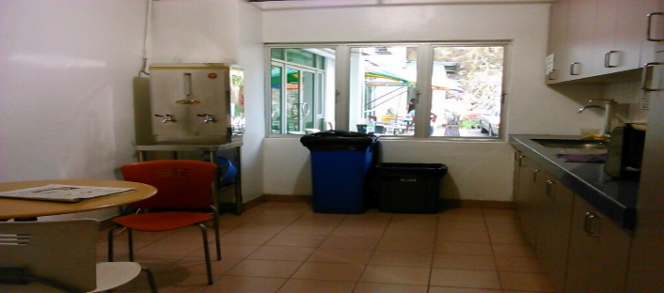
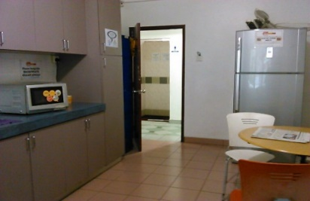
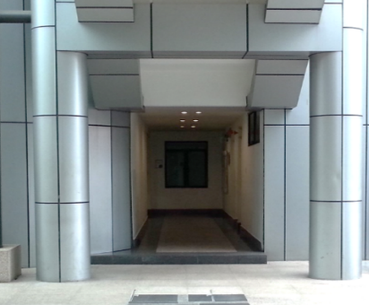
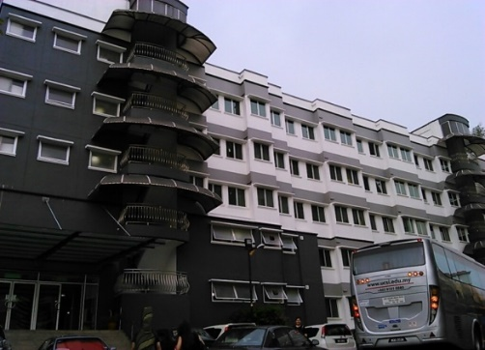
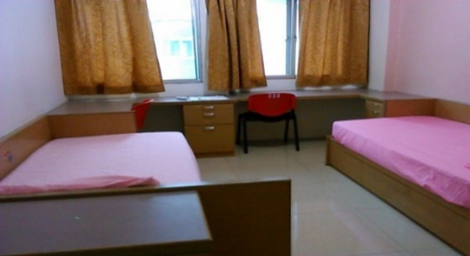
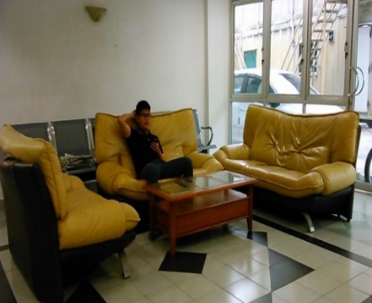
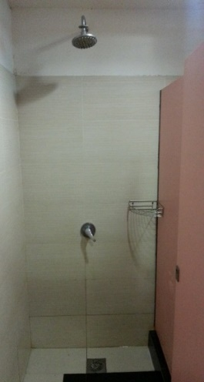
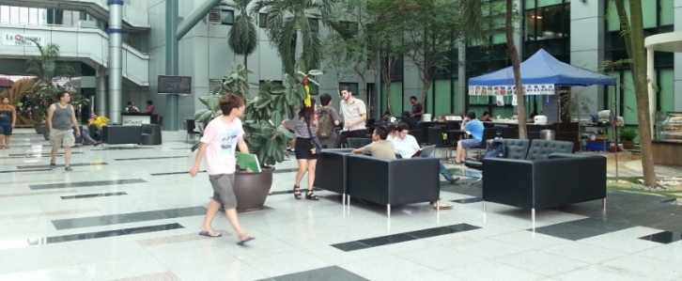
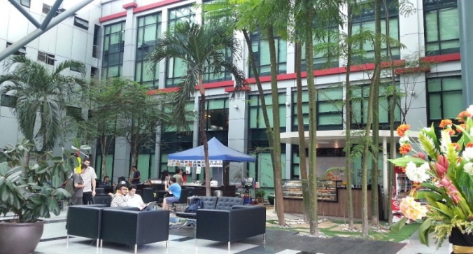

Slide 62
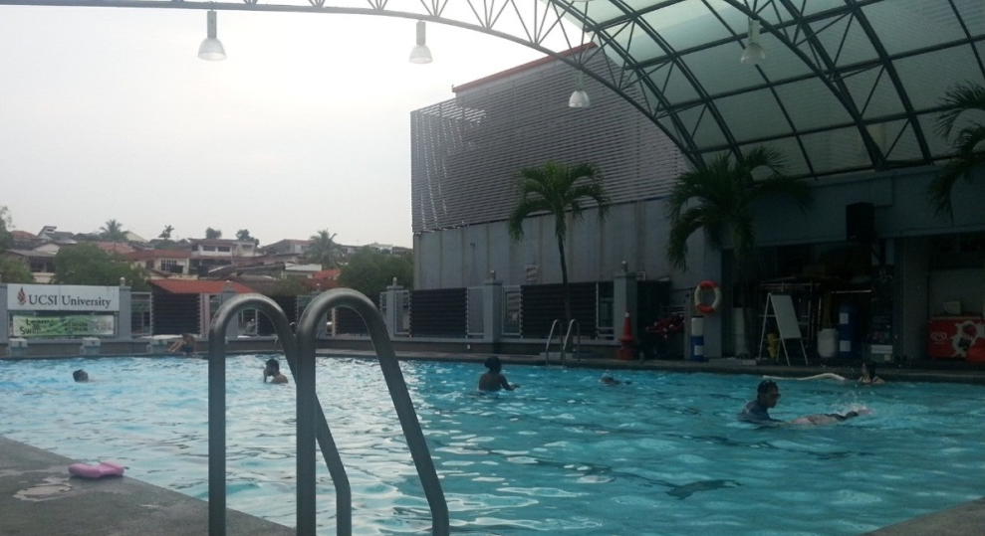
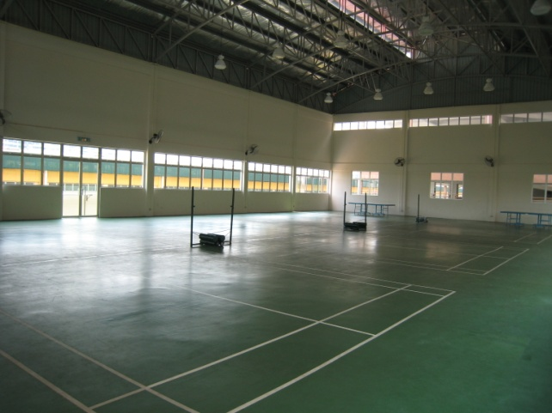
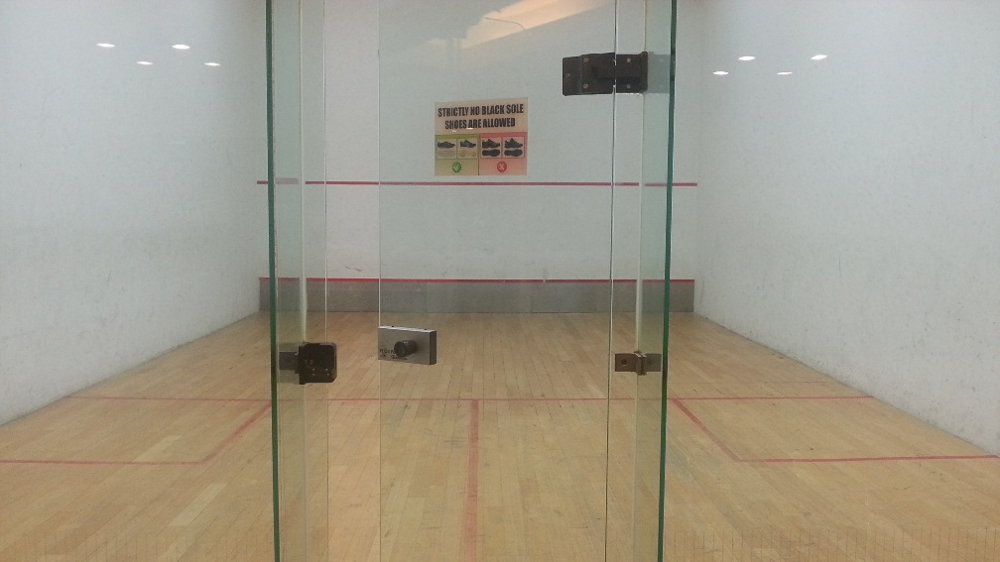
Badminton court
Basketball court
Squash court
Swimming pool

Slide 63
General Features
The Residential Hall boasts 24-hour security, CCTV monitoring and an access card system
Approximately 5 minutes walking distance to UCSI’s Academic Blocks
Approximately 5 – 10 minutes walking distance to restaurants, banks, stationery /printing shops
Approximately 10 minutes walking distance to Giant Hypermarket
Approximately 30 minutes travel distance to the nearest train station (Bandar Tasik Selatan)

Slide 64

Application Process
Fill in the On Campus Accommodation Form
http://www.ucsiuniversity.edu.my/student-support/accommodation/accommodation-download-kl.aspx
Booking fee of RM1,000 (Payable to UCSI Education Sdn Bhd)
The full payment of the semester’s rental must be upon checking into the Residential Hall
The tenancy period is based on the semester depending on the academic programme the student enrolled for.
The booking deposit shall be maintained throughout the tenancy agreement and it shall be refunded upon the completion of one’s tenancy.

Slide 65

Fill up the check-in form;
Get the door and wardrobe key;
Check-in to your room.
Check-In
Make sure you have remove all your belongings from the room;
Fill in the check-out form;
Return the door and wardrobe key;
Check-Out

Slide 66
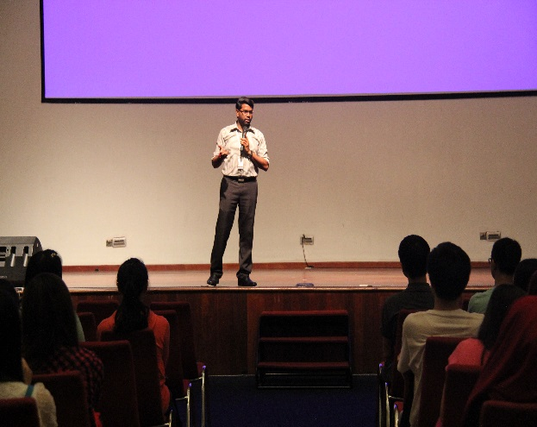

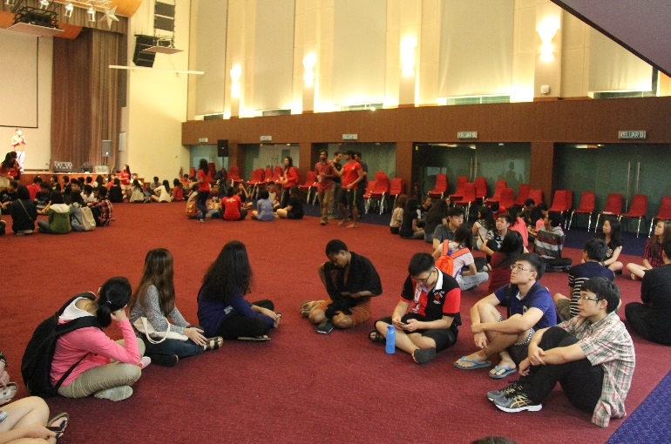
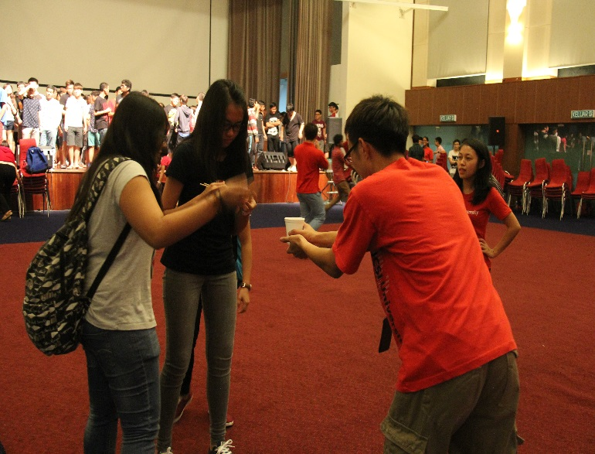
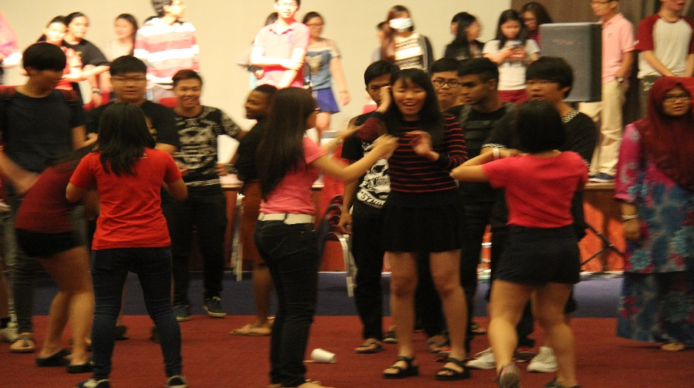
HOSTEL BRIEFING

Slide 67
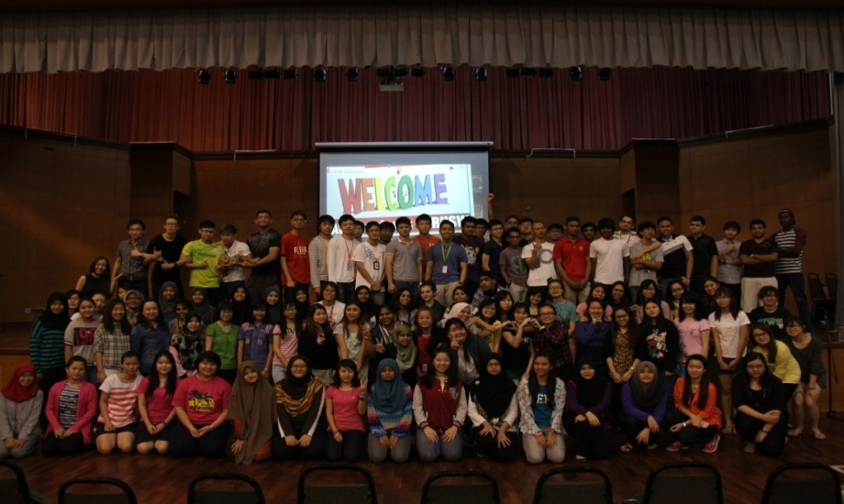
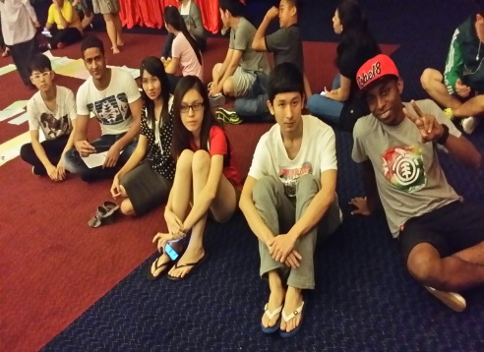
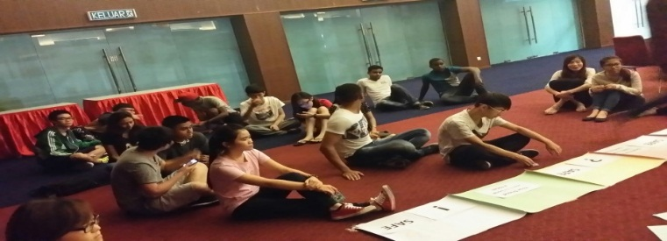
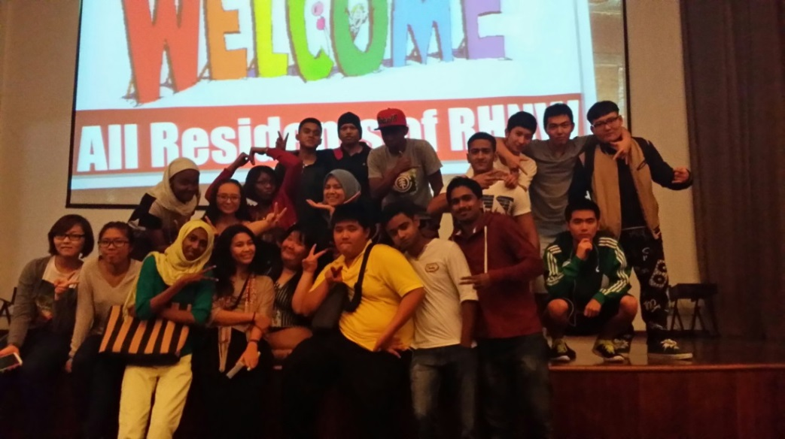


RESIDENTIAL LIFE (Welcome Night)

Slide 68
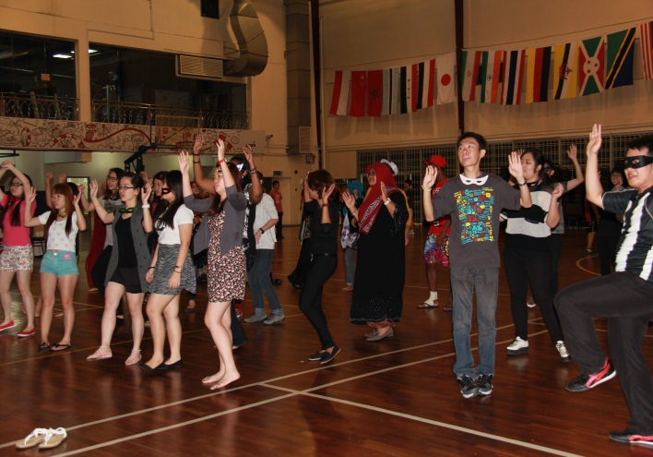
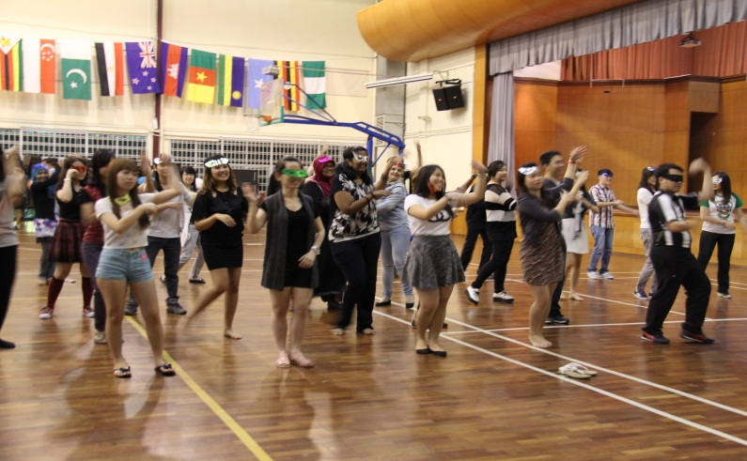

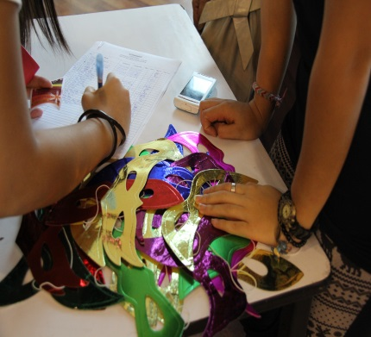


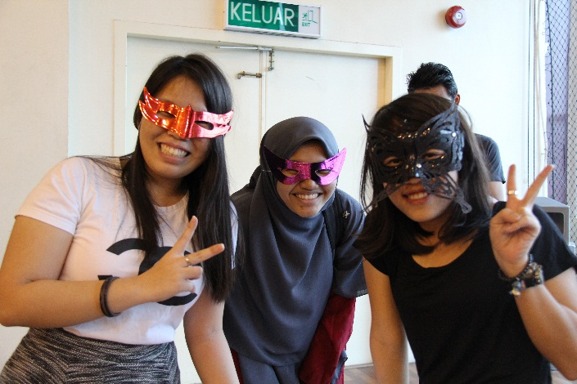

RESIDENTIAL LIFE (Zumba night)

Slide 69

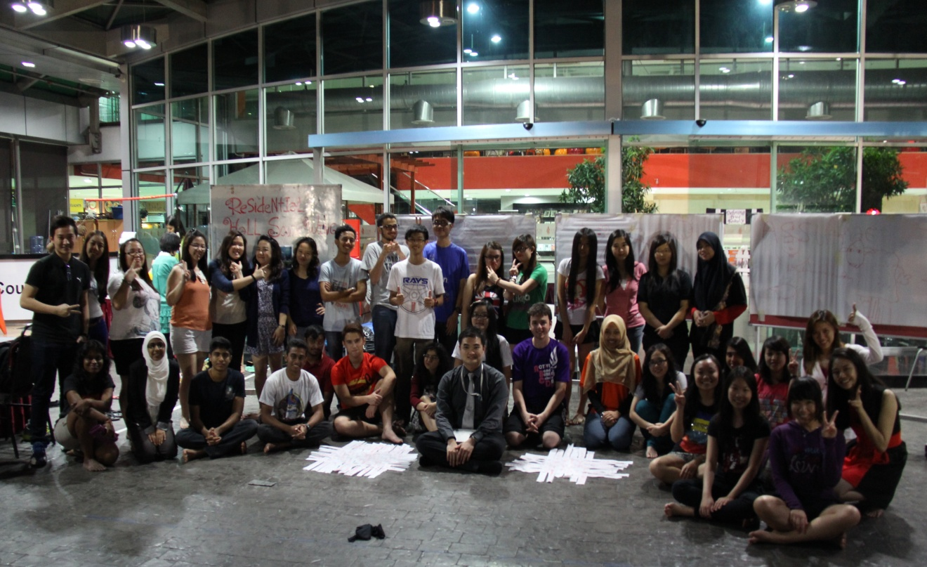
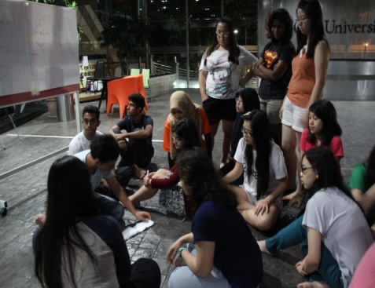
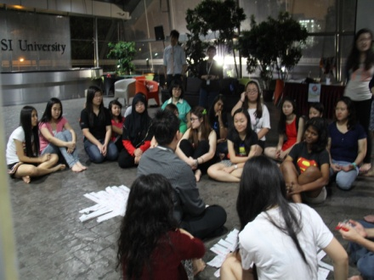
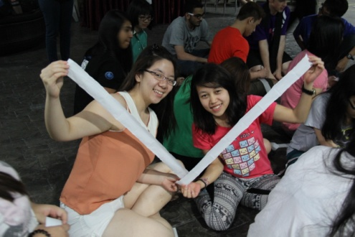
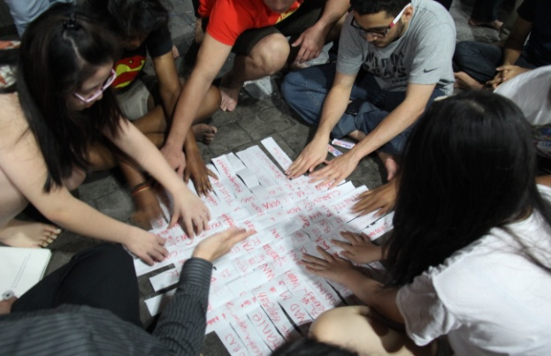
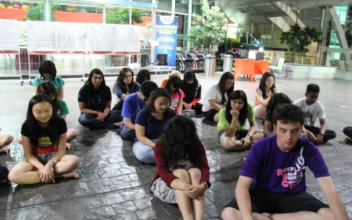
RESIDENTIAL LIFE (You, Me & World)

Slide 70
Contact Person
Ms Norazimah Binti Abdul Aziz Head, Alumni & Support Services Student Affairs & Alumni Division, Level 3, Block A, KL Campus (South Wing) rhall@ucsiuniversity.edu.my 03-9101 8880 (Ext. 2081) | Residential Hall South Wing (Block E) Ms Rosmaniza Binti Mat Rahim Executive, Student Affairs & Alumni KL Campus (South Wing) rhall@ucsiuniversity.edu.my 03-9101 8880 (Ext. 2000)
Residential Hall (Block D) Mdm Felicia Lee Puay Joo Senior Accommodation, Student Affairs & Alumni rhall@ucsiuniversity.edu.my 03-9101 8880 (Ext. 3451)
For more information, please visit UCSI University’s Website > Life at UCSI > Accommodation > Accommodation (Kuala Lumpur Campus)
http://www.ucsiuniversity.edu.my/student-support/accommodation/accommodation-kl.aspx

Slide 71

Integrated Information System (IIS) and Learning Management System (LMS)
Student Orientation

Slide 72
Contents
Introduction
To Access Current Students Page
Student Declaration
Pay Fees
The Course Selection Process
Course Selection – Courses Approval Status
Accessing to UCSI LMS CN Condition
Accessing to UCSI University Student Email System
Exploring UCSI LMS CN
Class Enrollment
Tips of UCSI LMS CN
Contact us
Single Sign-On Feature on Multiple Systems
Frequently Asked Questions

Slide 73








Introduction
IIS
LMS
Integrated Information System (IIS)
Social +
Learning Management System (LMS)
Common LMS Tools (Lessons, Test Quizzes, Homeworks and etc)
Social Networking (Experience classrooms with true diversity and build bonds internationally)
Select Course(s)
Check fees
Find global student with similar fields of study and interests worldwide.
Engage in learning discussions using Chat and Post tool
Make payment
Check results
IIS: Record / information purposes / administration platform
LMS: Academic-related information in an engaging environment

Slide 74
How to access the system
Accessing Current Students Page

Slide 75
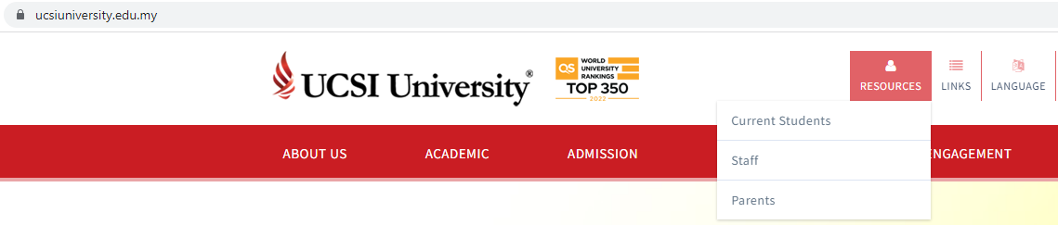
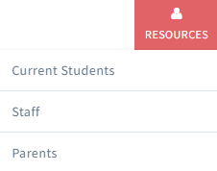
To Access Current Students Page
https://www.ucsiuniversity.edu.my/current-students

Slide 76
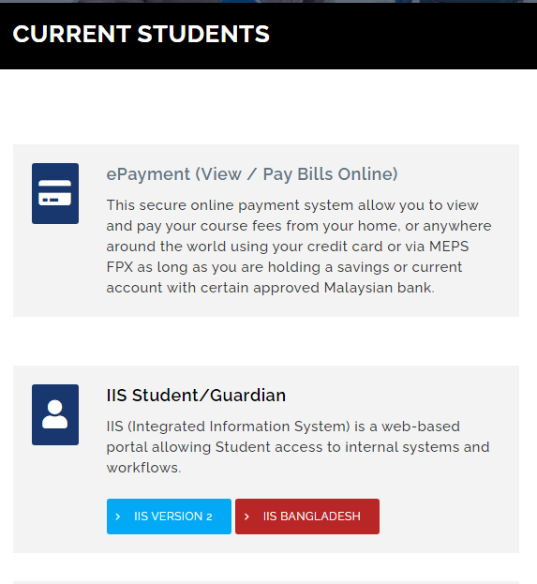
To Access Current Students Page
https://www.ucsiuniversity.edu.my/current-students
IIS Student/Guardian
1

Slide 77
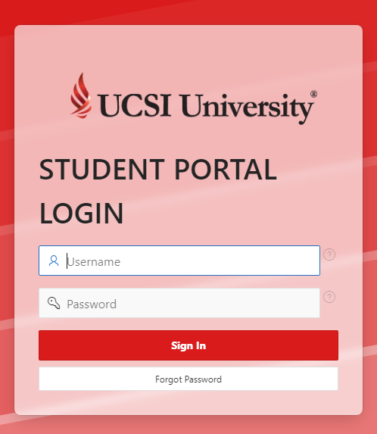
To Access IIS2
Once you click IIS Version 2, login screen as below will appear.
Username : student ID number
Password : as given in email

Slide 78
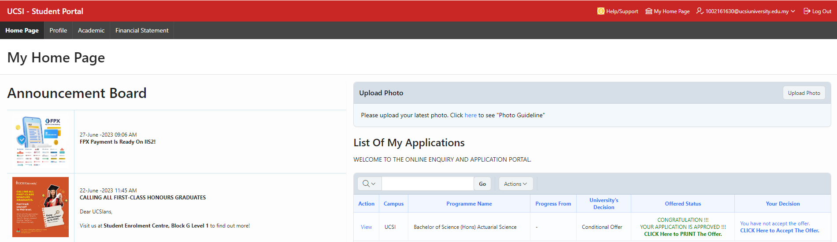
IIS Student Portal Homepage
Upon a successful login or password change, you will see the screen as shown below:-
Main function tab

Slide 79
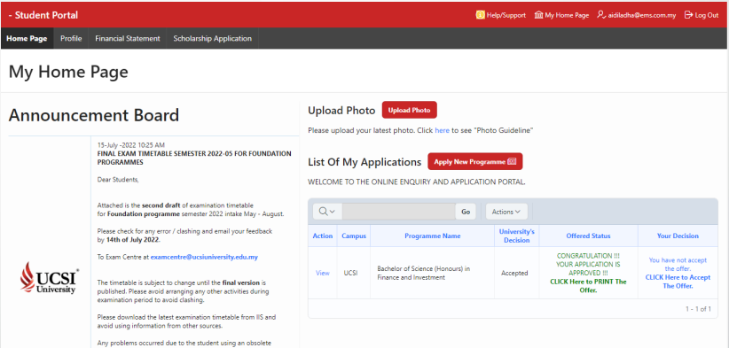
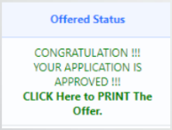
Print / View Offer Letter
Click at Offer Status box to print offer letter.

Slide 80
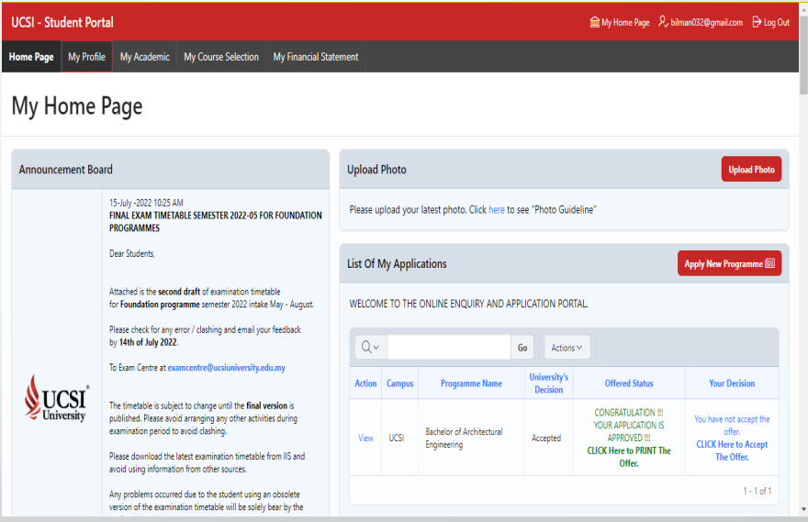
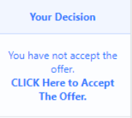
Accept Offer Letter
Click at Your Decision box to accept the offer.

Slide 81
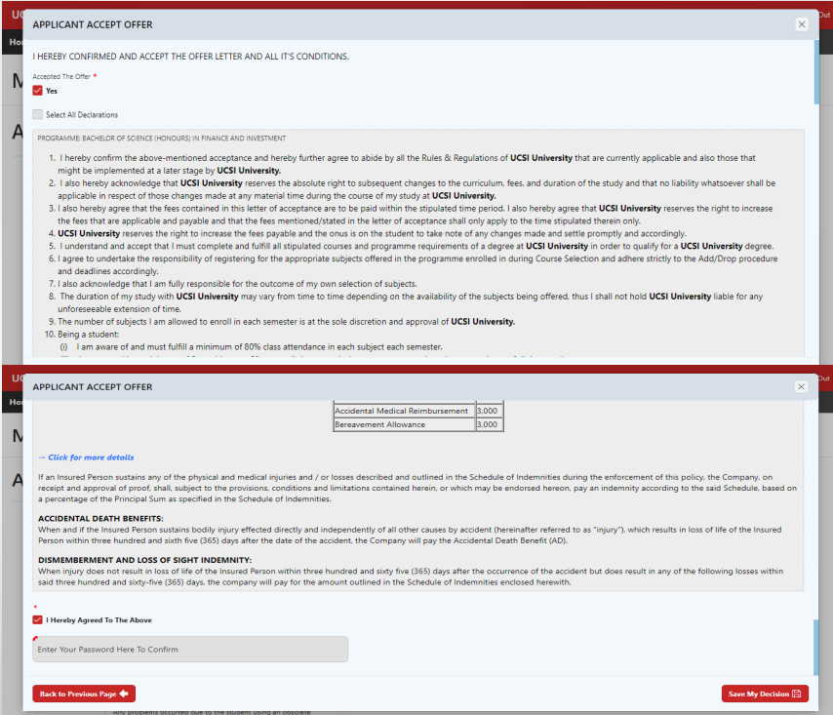

Student Declaration
1. Tick Select All Declaration or tick one by one.
2. Enter password for verification.
3. Click Save My Decision to proceed

Slide 82

Student Declaration
You have digitally signed the offer letter and can view the declaration accepted.

Slide 83

Pay Fees
Step 1:
Click on Financial Statement
Step 2:
Click Make Payment to pay

Slide 84


Pay Fees
Step 3: Click Pay Now
Step 4:
You can adjust the amount and click Distribute to allocate

Slide 85

Pay Fees
Step 5:
Tick the checkbox to agree with the policy
Step 6:
Choose the payment method and proceed

Slide 86
New Student – 3 Processing Stages
Pre-Course Selection (CS) Stage:-
Student declaration
Pay Fees (Fees information page)
√ Completed
√ Completed
During-Course Selection (CS) Stage:-
Select courses
Notes:
<Script – pg 20>
So, let’s review back 3 processing stages
[Click1] You have competed these tasks
[Click2] Next, let’s proceed to During-Course Selection Stage
<Script – pg 20>
3 processing stages;-
In the first stage is Pre-CS stage, student will just complete two tasks as stated.
Next stage is During-CS stage, student are about to enter to the class and study, but in order to make your name appear in the class, you will have to register by selecting the courses first.
Final stage is Post-CS stage, enroll to the class in LMS, get the lecture notes to study.
Let us now take a little step closer, I’ll show you where and how to perform the tasks…let’s starting from Student declarations.

Slide 87
The Course Selection Process
During-CS Stage
Begin Course Selection
Select courses or
Add & drop
Approval process
Require to Complete requirements*
Reject or Amend
Approved
Tutorial Classes or labs?
Completed
No
Yes
Select tutorials & labs
*Requirements:-
Student declarations
Pay fees, click “Paid” to update the status
Reporting arrival to Student Affair & Alumni (SAA) office (Located at level 9, Block G, UCSI South Wing campus)
Enrolment Conditions, English Placement Test And etc.

Slide 88
Course Selection
During-CS Stage
Definition
A process to select the courses you plan to study for the next semester.
Frequency
Before the next semester begins.
How do I know what courses to select?
Refer to the Y-Table, which will assist you in selecting your courses. If you are unsure, please refer to your respective school or department for advice.

Slide 89


Course Selection
After SAA reported for arrival, this field will appear in Home page
Step 1:
Click File Number to proceed
Step 2:
Click Begin Course Selection

Slide 90

Course Selection
Step 3:
Read and understand the Terms and Conditions
Step 4:
Check the box to proceed to next step
Step 5:
Click Proceed Course Selection to proceed

Slide 91

Course Selection
Step 6: Click Perform Class Selection Now to proceed

Slide 92

Course Selection
Step 7:
Click Add to choose course

Slide 93

Course Selection
Step 8:
Click the pencil icon to edit or drop

Slide 94

Course Selection
Step 9:
Once you have selected the courses, list of courses offered but clash will appear, click any course to see the details
Information on clashes course

Slide 95

Course Selection
Step 10:
Once you done the process, click the Back To Previous Page button.

Slide 96


Course Selection
Step 11:
Review selected courses.
Then scroll to the bottom of the page and click Proceed to Confirm Your Selection button

Slide 97


Course Selection
Step 12:
New invoice will appear.
You will see the tuition for the selected courses.
Click on Confirm and Submit button to submit for approval.

Slide 98


Course Selection
Alternatively, you may refer to Course Selection User Guide for Student in IIS2 Home Page.
Located under Announcement Document.

Slide 99


Course Selection – Course Selection Approval Status
During-CS Stage
Click Activities

Slide 100

Course Selection – Course Selection Approval Status
During-CS Stage
Click Activities
1.
2.
Info: Approval: Your selected courses have been submitted for approval
Info: Queued: Your course approval has been completed, please wait for system to process
3.
Info: Closed: Your course selection is closed and you may add/drop or select / edit lab & tutorial
P/S: Your Course Selection (CS) cycle is completed in Closed status. Your fees and timetable will be updated. LMS CN course(s) will be updated in the following day.

Slide 101
New Student – 3 Processing Stages
Pre-Course Selection (CS) Stage:-
Student declaration
Pay Fees (Fees information page)
√ Completed
√ Completed
During-Course Selection (CS) Stage:-
Select courses
√ Completed
Post-Course Selection (CS) Stage:-
Login to LMS
Enroll classes in LMS

Slide 102
UCSI LMS CN Status & Access
Please refer to the info below regarding CN account: -
The status of an active student with completed his/her first approved of course selection. (Note: For new student only)
The status of an active student with no outstanding fees in IIS will be set as active in UCSI LMS CN
The status of an active student with outstanding fees in IIS will be set as inactive in UCSI LMS CN if the payment is not completed before the due date. Thus, the student will not be able to access UCSI LMS CN.
After graduation the status of an active student will be changed to Alumni in UCSI LMS CN.
The account of a student with the “withdrawn” status in IIS will be deactivated in UCSI LMS CN.

Slide 103

To Access Current Students Page
https://www.ucsiuniversity.edu.my/current-students
1
Check LMS account activation in UCSI University Student Email System
Login to LMS from here
2

Slide 104

To Access UCSI University Student Email System
Post-CS Stage
ID: 1002xxxxxx@ucsiuniversity.edu.my
Same as IIS student portal password
For any email inquiries, please do not hesitate to contact Helpdesk@ucsiuniversity.edu.my

Slide 105

To Access UCSI University Student Email System
Post-CS Stage

Slide 106


UCSI LMS CN Email
Expand the email and follow the instruction
User ID: UCSI IIS Staff/Student ID
Password: IIS Password
Please click here to UCSI LMS CN

Slide 107



To Access UCSI LMS CN
A. Login via https://ucsi.thecn.com/
B. Institution Login via thecn.com
For e.g.: 1002xxxxxx
For e.g.: IIS password

Slide 108


Exploring UCSI LMS CN
Upon login, you will be prompted to take a page tour
You can find more guidance and features on “Help”

Slide 109
New Student – 3 Processing Stages
Pre-Course Selection (CS) Stage:-
Student declaration
Pay Fees (Fees information page)
√ Completed
√ Completed
During-Course Selection (CS) Stage:-
Select courses
√ Completed
Post-Course Selection (CS) Stage:-
Login to LMS
Enroll classes in LMS
√ Completed

Slide 110


Class Enrollment
You may find your course(s) on top or left navigation panel
Top Panel
Note: The course(s) will be added when your course selection is approved and updated in IIS
Left Navigation Panel

Slide 111




Tips
Update your information in your profile
Add your image
Start chatting with your online friends
Update the visibility to protect your ePortfolio privacy
Select relevant visibility setting when making a Post

Slide 112
Integrated Information System (IIS) and Learning Management System (LMS)
How To Reach Us

Slide 113
If you need support or more information
1. Walk-in
2. Email to
    iis@ucsiuniversity.edu.my (IIS)
    lmsmaster@ucsiuniversity.edu.my (LMS)
Computer Services Department
UCSI University South Wing (SW) Campus
Block E, Level 10.

Slide 114


Single Sign-On Feature on Multiple Systems
Single Sign-On (SSO)
Only one password to remember for multiple systems (IIS, UCSI LMS CN, Lab Computer, Wi-Fi, UCSI University Student Email)
SSO
UCSI Student Email System
IIS2 Student Portal
Domain Computer (Lab)
Wi-Fi
UCSI LMS CN
Back to top

Slide 115
Integrated Information System (IIS) and Learning Management System (LMS)
Q & A

Slide 116
Frequently Asked Questions (FAQ)
Q: What is Course Selection?
A: A process to select the course(s) you plan to study for the next semester.
Q: Why do I need to click ‘pay fees’ even though payment has already been made?
A: This section provides the information of your fees. The task is required to acknowledge and clear your payment status.
Q: How do I select my course(s)?
A: Course(s) selection can be done through IIS Student Portal.
Q: How do I know what course(s) to select?
A: Refer to the Y-Table, which will assist you in selecting your courses. If you are unsure, please refer to your respective school or department for advice.
Q: What do I do if my Course Selection isn’t successful to proceed?
A: Refer to the message prompted on the screen. Read through and check on the incomplete tasks.

Slide 117
Frequently Asked Questions (FAQ)
Q: What will happen after I’ve selected my courses?
A: All selected courses will need to go through the approval process, carried out by the Head of Programme (HOP) or the assigned course approver.
Q: When can I perform add/drop task or select tutorial(s)?
A: You can add or drop course(s) or select tutorial(s) in stipulated period for Add/Drop stated in the academic calendar and after your course selection status is indicated “Closed”.
Q: What should I do if the Head of Programme (HOP) advices me to add or drop the course(s) after approval?
A: There is a stipulated period for Add/Drop stated in the academic calendar. You can add or drop course(s) during the Add/Drop period.
Q: Who do I refer to in advance if the timetable is yet to be announced (TBA)?
A: Click on your course link to see more information. If the timetable status remains as TBA, kindly refer to the respective faculty.
Q: What should I do if the course(s) still pending approval?
A: Refer to the respective faculty.

Slide 118
Frequently Asked Questions (FAQ)
Q: What is UCSI LMS CN?
A: A social learning platform that allows students to access academic-related information in an engaging environment.
Q: What should I do to activate UCSI LMS CN?
A: Complete all assigned tasks (Student Declarations, Pay Fees, Report Arrivals, and Course Selection) in IIS student portal.
Q: Why I cannot see the course(s) in UCSI LMS CN?
A: Check your course approval status in IIS Student activities.
Q: How can I chat with friend(s) in UCSI LMS CN?
A: Add image in your profile then you can start chatting with your friend(s).
Q: How should I remove enrolled course(s) in my long list of course menu?
A: You can uncheck the course(s) shown in “Manage UCSI Course” menu on left navigation panel.
Happy studying!!!

Slide 119
Integrated Information System (IIS) and Learning Management System (LMS)
Thank you!

Slide 120

Perbadanan Tabung Pendidikan Tinggi National (PTPTN)
National Higher Education Fund Corporation

Slide 121
What is PTPTN?
The PTPTN Education Financing Scheme was established to provide education financing to students pursuing studies at local institutions of higher education. This education financing will enable students to fully or partially finance their course fees and the cost of living for the duration of their study.

Slide 122
Eligibility
Applicants must:
Hold Malaysian citizenship;
Not be a recipient of other loans (MARA or JPA LOAN) or scholarships (internal or external);
Possess a Sijil Pelajaran Malaysia (SPM) or O-Level qualification; or
Possess a Unified Examination Certificate (UEC) and qualify to study at UCSI University; or
Possess other recognised certificates to qualify for a degree programme: STPM, A-Levels, UEC, SAM, AUSMAT, CPU, CIMP, UCSI University Foundation, Local Matriculation or Recognized Diploma; and
Enrolled in a Private Tertiary Education Institution (IPTS) that offers a full-time degree or diploma course that is approved by the MQA & JPS.
  * The application requirements may vary from time to time. Please reconfirm with us upon applying for a PTPTN loan.
  ** Case by case basis. Please reconfirm with us upon applying for a PTPTN loan.

Slide 123
Eligibility (Continued)
Other criteria:
For students applying for the second time, loans extended earlier by PTPTN must be settled in full prior to a fresh application;
Students who have received PTPTN loan through previous colleges/universities but have left or have not completed their course are required to terminate the contract and make full payment with PTPTN before a new application can be made;
Students who have completed the diploma and received a PTPTN loan, kindly fill up Borang Penangguhan Bayaran Balik to extend your loan until completion of your degree programme;
Balance of study upon application must not be less than one year; and
As of Jan 2012, it is compulsory to open a Skim Simpanan Pendidikan Nasional (SSPN-i) account if students want to apply for a PTPTN loan.

Slide 124
PTPTN Loan Application Process
Check minimum academic requirements
Preparation before online registration
Register & submit the online application
Check application status
Applicants will be notified about their application status within 10 working days after the specified deadline via email and SMS.
If you did not receive any notification from PTPTN, kindly login to your account in PTPTN portal to check the status.
If your applications being rejected , kindly consult Officer in charge in SAA for further assistance.
If your applications being approved, kindly follow the instruction below.
Submit the loan agreement documents
Refer to http://www.ucsiuniversity.edu.my/admission/scholarship/ptptn-kl.aspx
Open CIMB Saving Account
Open SSPN-i Account
Buy BSN-PTPTN Pin No. (RM5/application valid for 6 months)
Refer to http://www.ucsiuniversity.edu.my/admission/scholarship/ptptn-kl.aspx
The loan agreement (surat tawaran) will be expired if the applicants did not submit it to the SAA within three (3) months from the agreement offer letter date.
Refer to http://www.ucsiuniversity.edu.my/admission/scholarship/ptptn-kl.aspx

Slide 125
PTPTN One-Stop-Centre
Should you encounter any difficulties in logging-in or in resetting the password, please contact:
PTPTN One-Stop-Centre
    Unit 1 & 2A, 2B,
    Level 2, Stesen Sentral Kuala Lumpur
    50470 Kuala Lumpur
Contact number : 03 2080 4455
Official Website : http://www.ptptn.gov.my

Slide 126
For more information pertaining to PTPTN, please visit our page here or direct your queries to Student Affairs & Alumni Division, at 9th Floor, Block G, KL Campus, UCSI University.

Slide 127

Student Feedback
Feedback consists of an inquiry, complaint, compliment and suggestion for improvement from students concerning the University, which includes but are not limited to the facilities, persons or services (academic or non-academic) and the operations of the University.
Purpose:
To create an avenue where students feel confident to raise their
concerns or compliments with the University and to speedily address
those concerns or compliments.

Slide 128
Student Feedback
Process : Submission must be made through the Student Feedback Form
or in written format via Integrated Information System (IIS)
Written format via Integrated Information System (IIS):
Log in to : www.ucsiuniversity.edu.my
Click Current Students
Click IIS Student / Guardian and log in your Student ID and password
Select “Activities”
Click : Submit Feedback to UCSI University
For enquiries, please refer to the Student Affairs and Alumni,
9th floor, Block G, KL Campus, UCSI University, Kuala Lumpur

Slide 129



Co-Op Education Centre
Job Placement Centre
The Co-Op Education Centre & Job Placement Centre were established in 2004 to provide integrated services to all UCSI University students, contributing to a rewarding career journey.
The Centres act as a liaison between students, employers and the different faculties within UCSI University to establish and facilitate employment opportunities. We also support, train and lead students and alumni as they build their careers.
Through the Centres’ partnership with various companies, students are able to experience quality and memorable internship. Today, we are proud to have around 4,000 Co-Op Employers worldwide.

Slide 130

What is Co-Op?
Co-Operative Education Module (Co-Op)
Workplace Training
Classroom Learning
Engineering programmes:
4 months (2 modules)
Non-Engineering programmes :
2 months (3 modules)
Each module amount to 3 credit hours
Grades are based on:
Employer’s evaluation
Written Co-Op assignment / report / logbook

Slide 131

Co-Op Framework
All students are required to perform their Co-Op attachments during the September semester each year, except for final year students who graduate before that time of year.
Engineering students will perform their Co-Op module in their 2nd and 3rd year. This normally takes place during the September semester.
  Co-Op attachment durations:
    For Engineering students:
    4 months per programme
    For Non-Engineering students:
    2 months per programme

Slide 132

Co-Op Prerequisites
Students must meet both the academic and non-academic prerequisites below:
Academic Prerequisites
    Required to complete at least 50% of all coursework each
    year / semester.
    Obtained a minimum cumulative grade point average
    (CGPA) of 2.0 (i.e. 50-59%) at the end of each academic
    semester. [NB: Most employers require a minimum CGPA of 2.5 (65%) or more]
    A student who does not meet the academic prerequisites
    is ineligible for Co-Op attachment that session
    and has to defer the Co-Op term to the following year/
    until the academic prerequisites are met.

Slide 133
Before the 1st Co-Op placement
Please follow the steps below before you start finding placements:
1) Watch the Co-Op e-briefing online:
(http://www.ucsiuniversity.edu.my/student-support/cec/cec/index.aspx)
2) Create your CV in the myCo-Op portal:
(http://www.ucsiuniversity.edu.my/mycoop)
3) Fill up the Enquiry Form to request for a Verification Letter (if required by companies):
(http://www.ucsiuniversity.edu.my/student-support/cec/cec/student/generalforms.aspx)
You may check out these channels to look for jobs you’re interested in:
myCo-Op Portal (http://www.ucsiuniversity.edu.my/mycoop/)
UCSI University Job Placement Portal (https://ucsicecsjob.wordpress.com/)
Facebook - UCSI University Alumni Network
Facebook – UCSI SAA
UCSI Student email (e-blast)
SAA Notice Boards (Block G, Level 9)

Slide 134







In-House Career Development Activities
SDS: Career Personality Test
InternsConnect
Career Fair
Community Project
Field Trip to Berjaya Group
Industrial Visit @ Lotus Cars Malaysia
Career Talk by
Tan Chong Motor

Slide 135
Student Activities & Recreation (SAR)
What Do We Do?
We oversee and provide guidance for the Extra-curricular Learning Experience course which promotes and encourage students to participate in activities beyond the classroom walls.
Provide guidance and support to the Student Council.
Provide guidance and support to student leaders of the various student organisations.
We provide guidance and support to students when events are being organised.
We help students to post their services, activities and events through the in-house print and electronic media.

Slide 136






Our activities @ a glance:

Slide 137
More programmes under us:
Community Engagement
Facilitation

Slide 138












House of Talents (H.O.T.)
fb.com/ucsihot
The Master Minds
Organise fun and exciting events to promote the talents
Express your creativity and visions by building a brand
The Talents
Perform and showcase your talents at various events or projects
Train with mentors and fellow talents
The sole purpose of this programme is to provide the talented students of UCSI University a platform to share, grow and showcase their talents.
For more information, email:
ucsihot@student.ucsiuniversity.edu.my

Slide 139
Community Engagement
The Community Engagement programme equip student volunteers with the necessary skills through training, conducted by eminent speakers, from UCSI University and external organisations.
To date, we have successfully achieved several successful events. While our on-going events include the Make A Difference Project (MAD), Care 4 Life, Malay Language Literacy Programme and Community Reading Programme.
We have more exciting and fun activities coming up. Your participation will definitely be beneficial for our community.

Slide 140















Facilitation Program
The Facilitation Programme aims to build a strong group of facilitators within the student community of UCSI University to facilitate them in various events organised by the Student Affairs & Alumni Division (SAA). Our objectives also include training our facilitators with people management skills and good communication skills.
Workshop
Paper Cutting for CNY
Communication Workshop
AGM 2015/2016
Facis assisted in SLS
Fund Raising
Committee Board Team Building
Facis assisted in Color Run
Members Team Building
UE Camp Organised by Facis and HOT
www.facebook.com/faciprogram
Facilitation Program UCSI
For more information, please look for Ms Hoh Ee Ling (hohel@ucsiuniversity.edu.my) @ Student Affairs & Alumni Division, 9th Floor, Block G, KL Campus (South wing), UCSI University

Slide 141


Our Services:
Coin Locker Service
Keep your belongings safe while you sit for your exam!
Location:
5th Floor, Block C,
KL Campus (South Wing), UCSI University,
Fees:
RM0.50 x 3
(only RM0.50 coins are acceptable)
Charges are on per usage basis
No overnight storage
For bookings and more information, please proceed to the Student Council Counter at Lobby, 1st Floor,
Block A, Kl Campus (South Wing), UCSI University

Slide 142

Student centre
Location:
1st Floor, Block A,
KL Campus (South Wing), UCSI University
Operating Hours:
Monday – Friday 9am – 9pm
Saturday 9am – 4pm
What can you find here?
Student Council Counter
Game Facilities: Pool Table, Foosball Table
Reading Area

Slide 143
Sports & Fitness:
What Do We Do?
We provide guidance and support to students when sport-related events are organised.
We encourage students to participate in various physical and recreational activities. Students can participate in a wide range of individual and team sports - in the inter-varsity competitions and intra-mural competitions.
We manage sports facilities such as the basketball court, table tennis facilities, badminton courts, gym, dance studio, volleyball court, outdoor futsal court, swimming pool, squash courts, pool table, football table and board games.

Slide 144


Sports Facilities at north wing
Location:
Kuala Lumpur Campus (North Wing), UCSI University
Operating Hours:
Monday – Friday 9am – 10pm
Squash Court
Futsal Court & Basketball Court
For booking and more information, please proceed to the Student Affairs & Alumni Division, 9th Floor, Block G, KL Campus, UCSI University

Slide 145




Sports facilities at SOUTh wing
Types of Courts:
Basketball Court, Volleyball Court, Badminton Courts
Location:
Multipurpose Hall,
4th Floor, Block A,
Kuala Lumpur Campus
UCSI University
Operating Hours:
Monday – Friday 9am – 6pm
For booking and more information, please proceed to the Student Affairs & Alumni Division, 9th Floor, Block G, KL Campus (South wing), UCSI University

Slide 146

Dance room
Practise your moves here!
Location:
Multipurpose Hall,
4th Floor, Block A,
Kuala Lumpur Campus, UCSI University
Operating Hours:
Monday – Friday 9am – 9pm
Saturday 9am – 1pm
For booking and more information, please proceed to the Student Affairs & Alumni Division, 9th Floor, Block G, KL Campus (South wing), UCSI University

Slide 147

gymnasium
To shape up and keep fit, students and staff may use the University Gymnasium, which has stationary bicycles, treadmills, free weights and machines.
Location:
5th Floor, Block A,
Kuala Lumpur Campus
UCSI University
Operating Hours:
Monday – Friday 9am – 9pm
Saturday 9am – 1pm
*Every Wednesday : Ladies only
For booking and more information, please proceed to Student Affairs & Alumni Division, 9th Floor, Block G, KL Campus (South wing), UCSI University

Slide 148

Swimming pool
It is meant for relaxation, competitive swimming and a chance opportunity to just laze under the sun.
Location:
Kuala Lumpur Campus (North Wing), UCSI University
Operating Hours:
Monday – Thursday 12pm – 8pm
Friday 12pm – 10pm
Saturday & Sunday 9am – 6pm
Note: Only individuals with proper swimming attire are allowed to enter the swimming pool.
For booking and more information, please proceed to Student Affairs & Alumni Division, 3rd Floor, Block A, KL Campus (South wing), UCSI University

Slide 149






Student Development & Counselling Department (SDCD):
What Do We Do?
Counselling
Development Programme
Academic Support Programme
Psychological Tools
VOIZ Bulletin
Self-help Brochures

Slide 150

Counselling
Counselling is a process that focuses on enhancing the psychological well-being of a client, so that the client is then able to reach his/her full potential. This is to be achieved by the counsellor facilitating the client’s personal growth, development, and self-understanding, which in turn empowers the client to adopt more constructive life practices. Counselling provides an opportunity for you to talk over your concerns in a confidential manner and it assists you to better understand yourself and situation in a new light, and to develop personal awareness to overcome issues.
Types of Counselling Services :
Individual Counselling
Group Counselling
E-Counselling
The counsellors can be reached through e-counselling at sacounselling@ucsiuniversity.edu.my

Slide 151

Development Programme
SDCD, through its experience, has identified some preventive and development tips that would enhance the students’ education journey in the University. Thus, the student development programme, through providing educational, developmental and preventive workshops, training and activities are beneficial to the community in the University.
Below are the programmes conducted by SDCD:
- Character & Value Building
- Self-discovery
- Personality Discovery
- Mental Health Issues
- Learning Challenges
- The Happiness Project
- Survival Kits in UCSI University

Slide 152

Academic Support Programme
The Academic Support Programme is specially designed to continuously support the students that seek for success in their academics and life. Through this programme, students will learn to understand that studying is easy with the right tools and efficient ways of managing their academic journey. We aim to equip UCSI students with multi-learning skills and techniques alongside assisting them in exploring the best way for them to succeed.
Under this programme, we have developed several workshops to meet the students’ academic needs and to facilitate the students’ academic progression. The list of the workshops are:
- Boost Your Memory
- Catch Your Breath
- Think Out Of The Box
- S.M.A.R.T Goal Setting
- V.A.K Learning Style
- Time Management
- P.O.W.E.R In Study

Slide 153



Psychological Tools
Personality Assessment- DISC Profile
The DISC Profile has opened the door to understanding the dynamics that influence communication and positive relationships for over 30 years. The foundation for success lies in understanding oneself, others and realising the impact of his/her behaviour on people. DISC focuses on four behavioural dimensions namely, D: Dominance, I: Influence, S: Steadiness and C: Conscientiousness.
Self-directed Search (SDS) Assessment
The SDS Assessment can help students to make the best career decisions wherever they are in life. Used by more than 30 million people worldwide and has been translated into more than 25 different languages, SDS results are supported by more than 500 research studies.
OH-Cards
Discover yourself from hearing your inner voice. The use of the OH cards addresses two spheres of experience: to put you in touch with yourself and to put you in touch with those around you.

Slide 154




Self-help Brochures
Notes:
To add the hyperlinks of all brochures

Slide 155
Contact & Location of SDCD
Email: sacounselling@ucsiuniversity.edu.my
Contact Number: 03-9101 8880 Ext: 2086/2087/2088
Location:
Student Affairs & Alumni Division,
9th Floor, Block G,
KL Campus
UCSI University

Slide 156

Where is the Library located?
Block B , The Resource Centre
UCSI University Library
No.1, Jalan Menara Gading,
UCSI Heights,
56000 Kuala Lumpur, Malaysia
Tel: 03-91018880 ext. 3205, 3207 & 3210

Slide 157






UCSI UNIVERSITY LIBRARY

Slide 158
MISSION
To provide excellent resources, services and facilities to support our customers’ requirements (student & staff) to enhance teaching, learning and research at UCSI University

Slide 159
OPERATING HOURS
South Wing Library
Monday - Friday : 8 am - 9 pm
Saturday : 9 am – 5 pm
Sunday : 9 am – 1 pm
Public Holidays : CLOSED

Slide 160


SERVICES
∙ Borrowing/Returning Services
∙ Inter-Library Loans
∙ Document Delivery Services
∙ Book Drops
∙ Self-Checks Machine
∙Information Skills Training & Workshops
Book drop Machine
Self-check Machine

Slide 161

FACILITIES
∙ Computer Laboratory
∙ Group Discussion Rooms
∙ OPAC (Online Public Access Catalogue)
∙Wireless Access Points
∙ Common Learning Areas
∙ Cafeterias

Slide 162

COLLECTIONS
What do we have for you?
Open shelf Books
Red-Spot Collections
Magazines
Electronic Resources
Audio-Visual Materials
Reference Books
Thesis/Project Reports

Slide 163
CIRCULATION SERVICES
Undergraduate/ Postgraduate Students | 5 books, 2 CDs, 2 magazines | General Collection (14 days) Red Spot (24 hours) CDs & magazines (2 Days)
Reference Materials / Project Reports / Thesis
are to be used only in the library.

Slide 164
RENEWALS, LOSS AND DAMAGES
Renewals
1. Library materials which have been borrowed may be renewed if they have not been reserved other users.
Renewals can be done twice only.
Renewals for overdue books are not allowed.
4. Loan renewals can be done one (1) day before the due date or on
the due date.
5. Users can now renew their loans online through OPAC, self check machine and through Circulation Counter.
Loss and Damages
Borrowers will be held accountable for the materials out on loan. If the material is lost, an immediate report should be made to the Librarian to enable appropriate actions to be taken.

Slide 165
LATE FINES
1-7 days : RM0.50 per day
Red spot books : RM0.50 per hour
As soon as a fine is incurred, all library-borrowing privileges will be suspended. Overdue notices are auto-generated by the library system and sent to the library user’s account. All recorded fines must be paid before borrowing privileges are reinstated.

Slide 166
HOW TO ACCESS THE LIBRARY PORTAL
&
ONLINE PUBLIC ACCESS CATALOGUE
(e-OPAC)
Log on to
OPAC direct URL https://koha.ucsiuniversity.edu.my/
Library Portal https://lib.ucsiuniversity.edu.my/

Slide 167


Slide 168


Slide 169


Slide 170


Slide 171


Slide 172


Slide 173


Slide 174


Slide 175


Slide 176





LIBRARY RULES AND REGULATIONS DISCUSSION ROOM
USE THE BOOK DISCUSSION ROOM IF YOU ARE HAVING A DISCUSSION WITH YOUR FRIENDS

Slide 177




IMPORTANT INFORMATION
1. Please use your Student ID card for all library services and facilities.
2. Renewal of library items can be done twice via e-OPAC or at the circulation counter.
3. Book drop services operates 24 hrs daily.

Slide 178

IMPORTANT NOTICE
Please take note of the below when using the barrier gate
at the library.
The barrier gate should only be accessed by one person at a time.
Please use your own ID. The sharing of IDs is not permitted. Once caught, you will be barred from using the library.
Any act of vandalism to the barrier gate will result in a penalty by the library and may subject to suspension by the management.

Slide 179
For any enquiries, please e-mail or contact us:
Nur Farizah Binti Zulrafar
farizah@ucsiuniversity.edu.my ext: 3207

Slide 180

Registrar’s Office

Slide 181
Registrar’s office
Responsibilities, Rules, Regulations & Procedures
Located at 2nd Floor, Block A
Operation hour:
  9.00am - 5.30pm (Monday – Friday)
  9.00am - 12.30pm (Saturday)
  *Closed (Sundays and Public Holidays)

Slide 182
Registration of New Students
To issue the Student Identification Card (UCSI1Card)
To review & update Admission conditions
Custodian of student’s records
Authenticate requests to change contact information i.e.: address / contact number (Home/mobile phone numbers) etc.

Slide 183
Registration of Courses
Students to perform the Course Selection (CS) through the Integrated Information System (IIS) Portal
Students to perform Course Selection for the next commencing semester during the Course Selection period (Refer to the Academic Calendar)
Students to undertake 15 credit hours (minimum) to 20 credit hours (maximum) or 4 to 5 courses in one semester
  If students unable to select minimum credit hours (9 credit hours for Short Semester or 15 credit hours for Long Semester), students MUST provide justifications to the Head of Department for clearance
Course Selection approval by the Head of Departments / Deans / Directors
**Total Credit hours undertaken for an academic year MUST NOT EXCEED 50 credit hours

Slide 184
Registration of Courses
Students’ responsibility to check the course status through the IIS Portal.
  Students to perform Add/Drop Courses by first week of new Semester. Please refer to the Academic Calendar for duration period.
  Students who perform Late Add/Drop or Withdraw Courses will be charged with penalty fees. Penalty waiver only will be considered if the delay in due to extenuating circumstance
  Students’ responsibility to follow the deadlines stipulated in the Academic Calendar
Students to add course(s) first upon commencement of semester for marginal fail / supplementary paper to avoid penalties.
  Students may drop the course(s) if passed the supplementary exams

Slide 185
Academic Performances
Students may self-generate semester results in IIS Portal.
Students to refer to respective lecturers for details of marks or overall results
Students receive Warning Letters upon advised by Faculty due to the following reasons:
  Poor Attendance (Below 80%)
  Poor Academic Performance (CGPA Below 2.00)
Students to response to Warning Letter within the stipulated deadlines. Students maybe terminated if fail to do so.
Students unable to view course Examination results due to cheating cases or outstanding fees.

Slide 186
Services - Administration
Issuance of letters for the following requests:
  EPF/MARA/SOCSO/PTPTN/Bank Loans
  Opening Bank Accounts/Travelling
  Programme Completion/Transfer to Other Institutions/Withdrawals
  **Processing time: 3-10 working days (for verification process) from the date of submission and/ or payment, if payment is involved

Slide 187
Services - Administration
No letters of travel issued IF:
  Students to travel is within semester (except for death of family members)
  Students to travel is within examination period even if exact date of examination is known

Slide 188

Services – Academic
Issuance of Graduation Certificate and Academic Transcripts
Convocation Ceremony
Verification of Completion status

Slide 189
Other Roles & Responsibilities
To process deferment request.
To process students Programme transfer request to new programme.
To process students’ Credit transfer request (Internal and External Credit Transfer Request).
To process Suspension due to misconduct or cheating.
To process Termination Letter due to poor attendance, consecutive inactive semesters, nuisance, cheating etc.
Students to refer to Undergraduate Student Handbook for detailed information.

Slide 190
Student’s Responsibilities
To understand and comply with all the rules, regulations, procedures and guidelines stated in the Student Handbook (Procedures & Guidelines).
To behave and act in a responsible and orderly manner at all times and avoid engaging in a behaviour which will disrupts the academic environment
To maintain regular contact with your respective Centres/Faculties/Institutes/Schools, and duly notify them of any difficulties encountered to obtain the necessary advice
To adhere to all deadlines set by the University and/or by lecturers/staff of the University.

Slide 191
Student’s Responsibilities (Cont.)
To respond to reasonable requests from staff without any undue delay.
To make full use of the resources and support services provided such as student email, library, etc.
To keep your personal and contact details up-to-date in IIS Portal and to provide true and accurate information for the University’s future references
To refer to the Academic Calendar, Student Handbook (Procedures & Guidelines) and Programme Handbook from time-to-time.

Slide 192


If you have any inquiries or concerns
Contact Us
registrar@ucsiuniversity.edu.my
0391018880 (Ext: 3027, 3130, 3121, 3135)

Slide 193

UCSI University
Global Engagement Office (GEO)

Slide 194
What we do at GEO
Student Exchange Programmes
International Degree Pathways

Slide 195

UCSI University
Student Exchange Programme

Slide 196

Global Engagement Office
More than 60 partner universities for exchange and research attachment.
Tuition fees at exchange partner is waived.
Pay only for credit transferable courses to UCSI University.

Slide 197

Partner universities

Slide 198
Types of outbound exchange
Items | Large Group Exchange | Research Attachment | Academic Exchange (classes) | Internship Exchange
Program fees | Tuition fees waived
Duration | 1 semester (2 or 4 months) | From 2 months onwards depending on projects | 1 to 2 semesters | 1 semester
Delivery | In groups of more than 10, chaperoned by UCSI staff | Attachment to a supervisor in partner institution | Students to get faculty's approval for credit-transferable courses before deciding on classes to attend in partner institutions | Offer and Placement via partners
Visa | Student visa is required
Other applicable fees | Administrative - depending on partner
Optional fees | Accommodation - depending on partner |  |  | Accommodation - depending on partner Allowances - depending on employer

Slide 199

Large Group Arrangements

Slide 200
Global Engagement Office
VIETNAM | CHINA | MOROCCO | JAPAN
Travel | Explore | Network | Connect | Experience
sending large groups of 15- 20 UCSI students to partner universities
chaperoned by UCSI staff (Faculty lecturers or GEO staff)
for research projects, internship placements, or academic exchange (credit-transferable subjects)
Duration: 1 semester (4 months) or 2 months

Slide 201

Student Exchange Registration Form
Application Periods & Deadlines
Majority partner Institution operates with a 2 semester per year academic calendar.
Application Deadlines varies from partners to partners, as early as 4-6 month ahead of intakes/ semester commencement.
Similar lead time is recommended for the internship exchange, due to the interview process.
GEO shall coordinate the timings of partners with the faculties and/or academic centers.

Slide 202

Outbound exchange steps:

Slide 203
UCSI University international degree pathway

Slide 204

many more..

Slide 205
Advantages of embarking IDP
Global Experience
Cost Effective
Flexible Options
Higher Employability

Slide 206

United kingdom
a) Pathways :
1+2 pathways - Engineering, Business, English Language, Applied Science , Arts and Design
2+1 pathways - Business, English Language, Arts and Design
b) Fees :
Annual Tuition Fees: GBP 12,000* – GBP 16,000*;
Annual Cost of Living: GBP 9,600*– GBP 12,100*
(* Subject to change)
c) Intake : September

Slide 207







Uk
 | Bachelor of Science (Hons) Information Technology Bachelor of Science (Hons) Computer System Engineering Bachelor of Arts (Hons) Interior Architecture Bachelor of Arts (Hons) Animation Bachelor of Arts (Hons) Graphic Design Bachelor of Arts (Hons) Fashion Design
 | Bachelor of Arts (Hons) Accounting and Finance. Bachelor of Arts (Hons) Business Management Bachelor of Science (Hons) Psychology Bachelor of Science (Hons) Applied Psychology
 | Bachelor of Science Actuarial Science Bachelor of Business Administration Bachelor of Science Marketing Bachelor of Science International Business Bachelor of Arts English Language and Linguistics
 | Bachelor of Engineering Electronic and Electrical Engineering Master of Engineering Electronic and Electrical Engineering Bachelor of Engineering Mechanical Engineering Master of Engineering Mechanical Engineering
 | Bachelor of Arts (Hons) Fashion Design with Marketing & Production Bachelor of Arts (Hons) Fashion and Textiles Buying Management
 | Bachelor of Arts (Hons) Mass Communication Bachelor of Arts (Hons) Graphic Design Bachelor of Arts (Hons) Digital Media Design
 | Bachelor of Science (Hons) Food Science & Nutrition

Slide 208

AUSTRALIA
a) Pathways :
2+2 pathways - Engineering
1.5+ 1.5 pathways- Business and Applied Sciences
b) Fees :
Annual Tuition Fees: AUD 48,000*– AUD 52,000*;
Annual Cost of Living: AUD 38,000*- AUD 40,000*
(* Subject to change)
c) Intakes: February and July

Slide 209





AUSTRALIA
50th QS world University Ranking 2023

Slide 210

Contact Us
IDP/Student Exchange Office
Block G, Level 10
Email:
geo@ucsiuniversity.edu.my

Slide 211





CENTRE OF RESEARCH FOR RESEARCH,
VALUE INNOVATION & ENTREPRENEURSHIP (CERVIE)

Slide 212





Centre of Excellence for Research, Value
Innovation and Entrepreneurship (CERVIE)
Established in year 2010 under the DVC (Research & Postgraduate) Office
Aim to promote research, value innovation and entrepreneurship as one of the University’s core drivers.
Operate based on FOUR (4) main strategic thrusts:
Internal Capabilities
Smart Partnerships
Enterprise Value Innovation
Knowledge Dissemination
Assoc. Prof. Ts. Dr. Lionel In
Director, CERVIE
lionelin@ucsiuniversity.edu.my

Slide 213

CERVIE’S SCOPE & RESPONSIBILITIES AS
UCSI UNIVERSITY’S RESEARCH MANAGEMENT CENTRE (RMC)
RESEARCH FUNDING, CONSULTANCY & GRANTS
UNIVERSITY RATINGS & RANKINGS
COMMUNITY & INDUSTRY PROJECTS
NATIONAL & INTERNATIONAL LINKAGES
INNOVATION, INTELLECTUAL PROPERTY & COMMERCIAL-IZATION
RESEARCH PUBLICATIONS

Slide 214



UCSI University Praxis, Industry and Community Engagement (UCSI PICE) was established on August 2020 to coordinate, manage and engage UCSI’s students and staff with industry and community groups related to industrial research, commercialization and outreach activities.
The office supports activities with relevant stakeholders to establish and enrich the Praxis, industry linkages and community engagement environment between UCSI and the collaborators.
Roles & Responsibilities:
Coordinate and connect UCSI’s researchers, staff and students with industry, government and community groups that are interested in industry research and outreach activities.​
Plan, drive and monitor industry and community engagement activities for UCSI.
Build, implement and enhance strategic partnerships between university, industries, community and government agencies; both national & international.
Promote and enhance visibility of UCSI through information dissemination, programs and activities with industry & community partners.
Assoc. Prof. Dr. Elango Natarajan
Deputy Director (PICE)
elango@ucsiuniversity.edu.my

Slide 215







2021
2022-2023
UCSI Press Books Launched in 2022
Prof. Dr. Garry Tan
Editor-in-Chief
GarryTan@ucsiuniversity.edu.my
2024-2025
UCSI Press to be recognized as one of the prime university publishers in Malaysia and the regions.
UCSI Press to be registered with Majlis Penerbitan Ilmiah Malaysia (MAPIM).
Commercialization program
Branding activities to be conducted.
The establishment of UCSI Press. The Press is registered as one of the publishers under National Library Malaysia.
UCSI Press website to be launched by 2022.

Slide 216


Slide 217
CERVIE Contact Information
Address
Centre of Excellence for Research, Value Innovation and Entrepreneurship (CERVIE)
10th Floor, Block G, KL Campus, UCSI University
Telephone
+603-9101 8880 ext: 2257, 2256, 2454
Email
General Enquiries
Cervie_ucsi@ucsiuniversity.edu.my
Assoc Prof Ts. Dr. Lionel In Lian Aun
Director
lionelin@ucsiuniversity.edu.my
Dr. Wang Kang Han
Research Manager
wangkh@ucsiuniversity.edu.my

Slide 218

EXAMINATION CENTRE

Slide 219

IMPORTANT THINGS :
√ Final Examination Timetable
√ Eligibility, Barring and Un-Barring
√ Rules, Regulations & Procedures
√ Absenteeism
√ Plagiarism, Cheating and Misconduct
√ Examination Slip
√Supplementary Examinations
√ Appeals for re-evaluation of results

Slide 220
FINAL EXAMINATION will be conducted at the END OF THE SEMESTER :
Refer Academic Calendar in IIS Portal
General Programmes – Week 15 and Week 17
Foundation Programmes – Week 13 & Week 15
Master Programmes – Week 15 & Week 17
Examination timetable will be published in the IIS portal.
You have to:
❶ Ensure that you are ELIGIBLE to sit for the examination (no
outstanding fee and barred)
❷ Make sure you have the EXAMINATION SLIP and STUDENT ID to enter the
exam hall/Venue

Slide 221
BARRED & UNBARRED FROM EXAMINATION
❶ POOR ATTENDANCE
Attendance less than 80%
Student will receive email notification from IIS system
Appeals to consider unbarring with valid reason are to be made to the course lecturer (NOT the Registry / Exam Centre)
Lecturers will UNBAR if the appeal is successful
❷ OUTSTANDING FEES
Student who failed to settle the outstanding fees by the last day of classes will be barred from the final examination sitting.

Slide 222

ABSENCE FROM EXAMINATION
Two (2) common reasons: MEDICAL or NON-MEDICAL
Obtain the ABSENTEEISM EXAMINATION FORM from IIS Announcement Board: Announcement Documents
MEDICAL
NON-MEDICAL
● Submit official MC issued by a doctor from Laurent Bleu Medical Clinic, government or private hospital & clinics WITHIN 5 CALENDAR DAYS from the exam date.
● Dental Chits & Time off slips –
not accepted.
Non-medical reasons – accompanied with a letter WITHIN 5 CALENDAR DAYS and this is subject to the approval from University Exam Board.
(example : looking at the timetable wrongly)
Will not be accepted.

Slide 223

APPEAL OF MARKS
√ Online Application (via Student Portal)
√ Faculty to review for the final examination answer scripts only
√ Applicable for that particular semester within the stipulated time set in the Academic Calendar ONLY
√ Payment for the processing fee must be made at the Finance Office BEFORE the DEADLINE (online payment will be processed within 3 WORKING DAYS)
√ Outcome of the appeal will be notified through email and in the IIS system

Slide 224
SUPPLEMENTARY EXAMINATION
● Subject to Eligibility (grade C- or subject to UEB approval)
● Online Application (via Student Portal)
● Make payment at the Finance Office BEFORE the DEADLINE (online payment will be processed within 3 WORKING DAYS)
● Must attempt during the scheduled periods stated in the Academic Calendar
● Marks to be capped at 50% (Grade C)
● ABSENCE from the supplementary examination NOT applicable
● APPEAL to review the supplementary results is NOT applicable

Slide 225


Slide 226

Thank you
EXAMINATION CENTRE

Slide 227

PEER ASSISTED LEARNING (P.A.L)

Slide 228





eer
ssisted
earning
Study Sessions
Student-led study sessions for challenging academic courses (courses with high failure rate).
All sessions are led by trained P.A.L. student mentors who have previously succeeded in the course.

Slide 229


eer
ssisted
earning
Writing Clinic
P.A.L. Writing Mentor will work with you on your assignments, helping you in structuring your essays, improving sentence clarity or grammar.

Slide 230





P.A.L Website
https://www.ucsiuniversity.edu.my/peer-assisted-learning

Slide 231

P.A.L Facebook
P.A.L Facebook

Slide 232

Hear from our mentees
“I was guided in P.A.L. for a few subjects and the mentors were really great. They helped me with the subject material and made it easier for me to understand it” – Yi Xin
“P.A.L. helps boost my knowledge in Mass Transfer, as well as gets me ready for the coming assessments” – Ervinna Roxanne, Dineswari, Thaarani, and Loveroyce

Slide 233




Your Academic Journey begins here…..
Make it a good one!
03-9101 8880 ext:2255 (Ms Chai)
03-9101 8880 ext:2049 (Mr Brandon Tan)
https://www.ucsiuniversity.edu.my/peer-assisted-learning
pal@ucsiuniversity.edu.my

